Slide 1
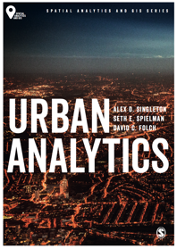
Urban Indicators
Alex D Singleton, Seth E Spielman, David C Folch (2017) Urban Analytics. London: Sage.

Slide 2
Learning Objectives
Composite indicators have a history of use within cities.
There are differences between univariate and multivariate indices and their application.

Slide 3
Indices
A composite index takes many different input variables and reduces them into a single number.
They are widely used because some things we want to measure in urban areas are a function of multiple inputs.
Wealth - your salary, your property (e.g., house), and your investments
Usually scaled – e.g. 0 – 100 or 0 – 1
Inputs typically need rationale
Input suitability cannot be assumed to be applicable universally between different geographic context
An index can be multidimensional in terms of input
the outputs are univariate composites
often used to rank areas or partition into ranked groups.

Slide 4
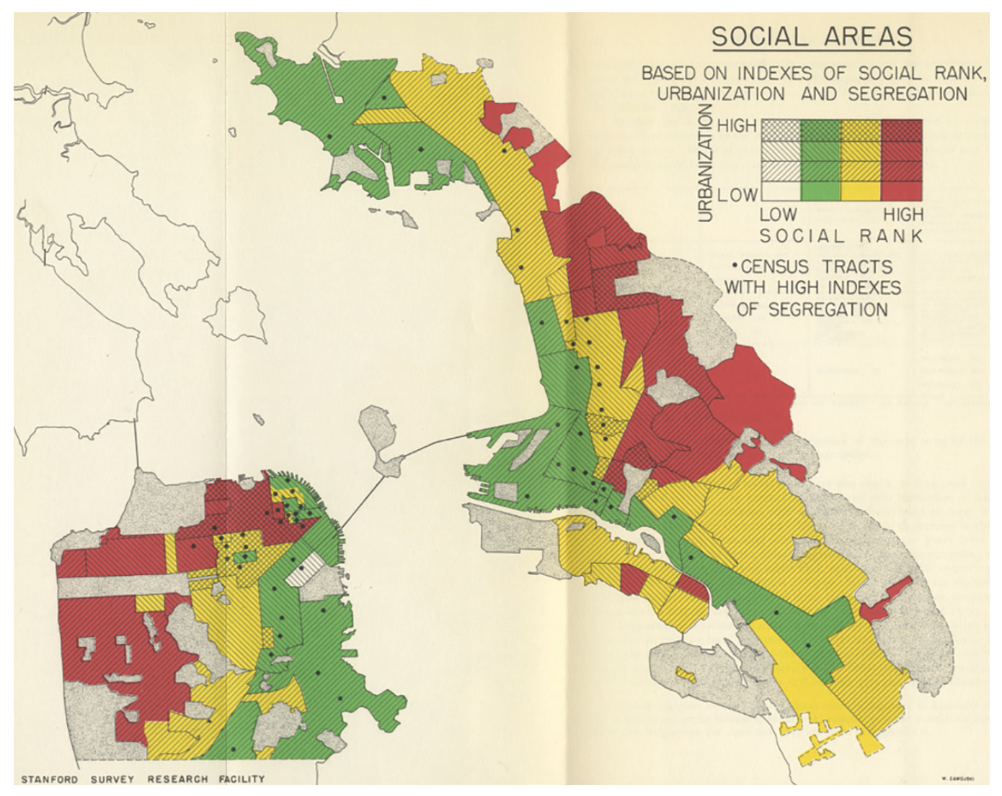
Early Urban Index
Social Area Analysis of the Bay area, san Francisco
Source: Map from ‘social area analysis’ by Eshref Shevky and Wendell Bell

Slide 5
Contemporary Index
Where economic resources and the interventions they enable might be best targeted?
UK – a number of Indices of Multiple Deprivation
Latest English indices of deprivation were released in 2015
Generated at the lower super output area (LSOA) scale (32,844 in England, with an average of 1,500 residents)

Slide 6
Contemporary Index
Domains
Employment deprivation
Education, skills, and training deprivation
Health deprivation and disability
Crime
Barriers to housing and services
Living environment deprivation.
Data
Administrative Sources
Methods
Shrinkage technique
Combined through factor analysis

Slide 7
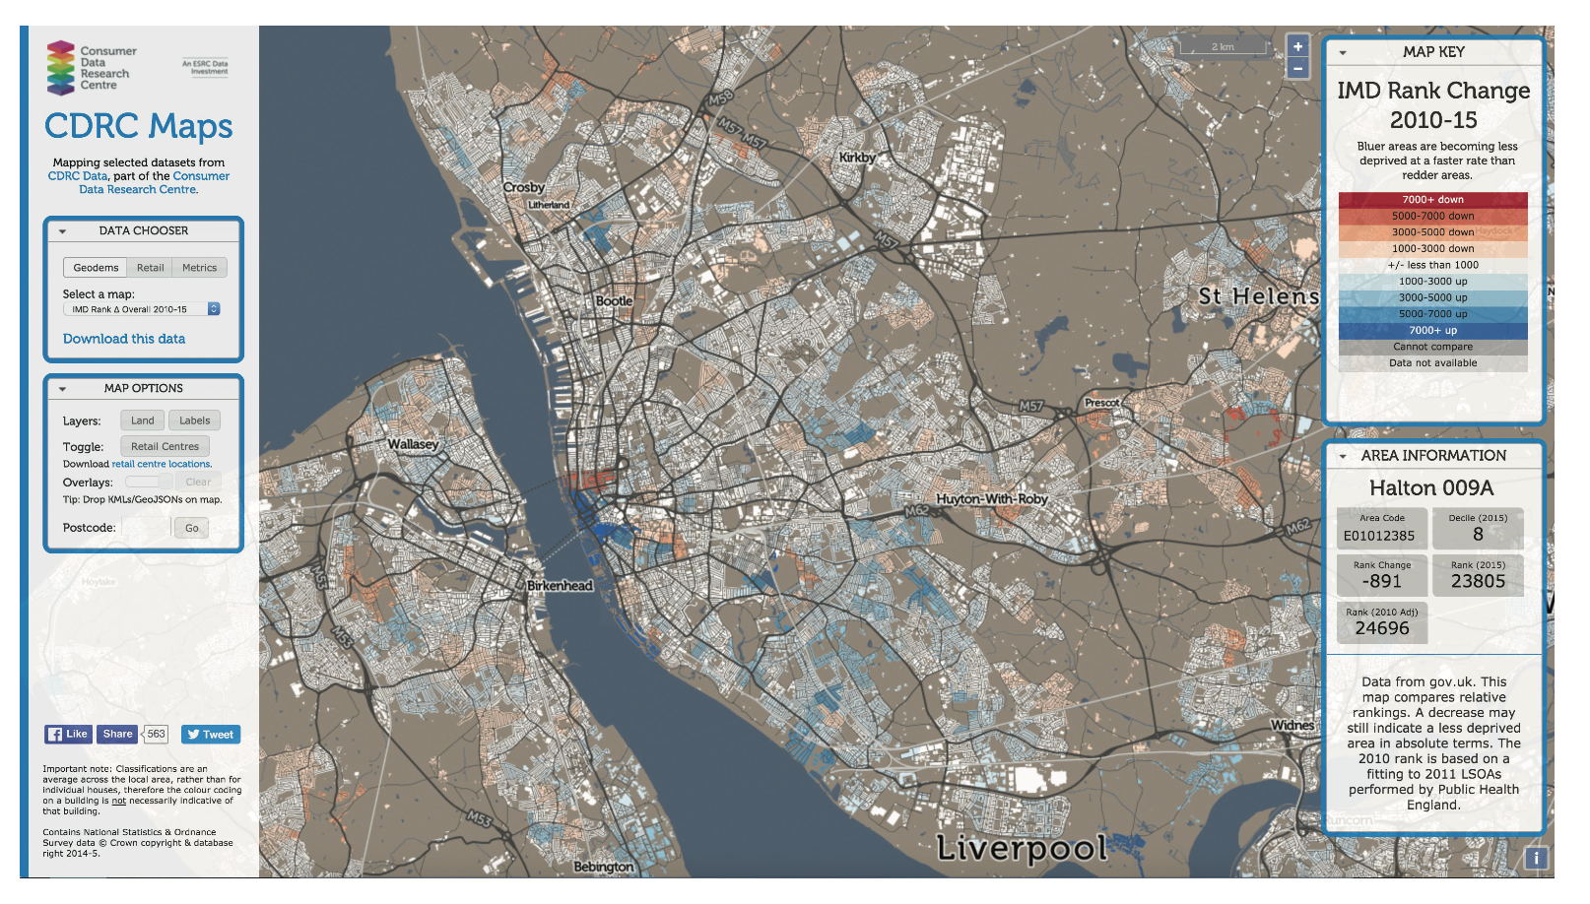
Contemporary Index
The maps.cdrc.ac.uk website showing the change in IMD rank of LSOA between 2010 and 2015
Source: maps.cdrc.ac.uk is developed by Ollie O’Brien, University College London, UK. Reprinted with permission.

Slide 8
Building an Index
Most indices are constructed from a range of variables
Could be drawn from across multiple measurement scales
Typically use a standardization technique
E.g. Z-Score
Sum of raw or weighted scores
There are many ways of building indices which range in complexity

Slide 9
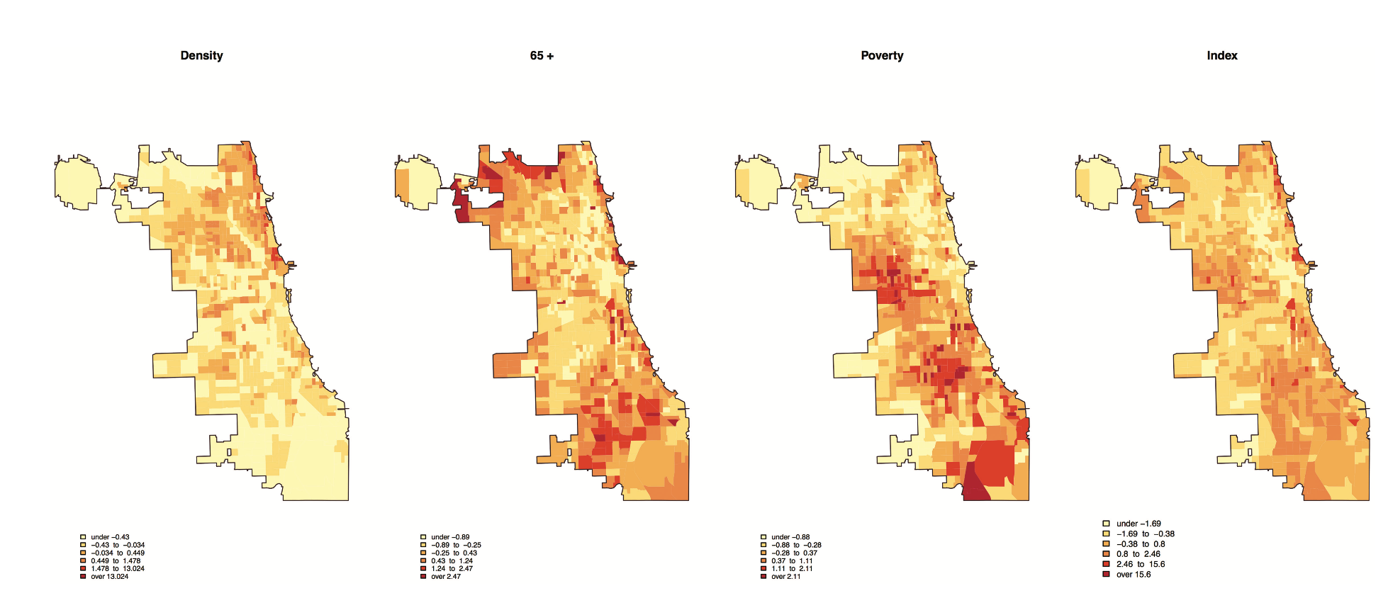
Building an Index
Calculating an index using z-scores for: density; percent aged 65+; percent in poverty; and index of the three measures
Source: authors’ own; data – Us Census Bureau, American Community survey 2014

Slide 10
Conclusions
Indicators have a history of use in the description of different aspects of urban geography
They are usually used to describe latent structure
Often multidimensional in terms of input
No single way of building an index

